Slide 1
Lecture 3 – Extension: Design Example and Exercise
CS582
Machine Learning: Getting Computers
to Program Themselves
“Discovering the Learning Dynamics of the Laws of Nature”
Dr. Emdad Khan
ekhan@mum.edu
Dept. of Computer Science
Maharishi University of Management
May, 2018

Slide 2
A Machine Learning Design Example & Exercise using Neural Network
We have covered Basics of ML, Perceptron, Back Propagation, Training, Testing, Validation and Evaluation Criteria.
Now it is time to do a design example using Supervised learning with Perceptron / Back Propagation.

Slide 3
A Machine Learning Design Example & Exercise using Neural Network
A typical neural network application is classification.
Consider the simple example of classifying aero-planes given their masses and speeds – Next slide.
Use a neural network (starting with a Perceptron) to do the classification task.

Slide 4
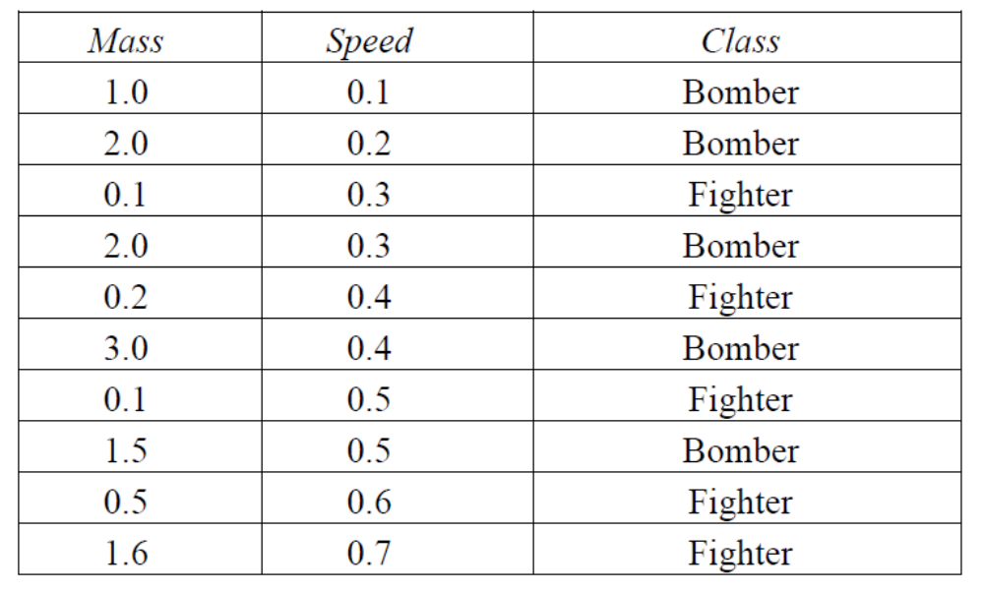
Data for Aero-plane Classification

Slide 5
General Procedure for Building Neural Networks
Formulating neural network solutions for particular problems is a multi-stage process:
1. Understand and specify your problem in terms of inputs and required outputs, e.g. for classification the outputs are the classes usually represented as binary vectors.
2. Take the simplest form of network you think might be able to solve your problem, e.g. a simple Perceptron.
3. Try to find appropriate connection weights (including neuron thresholds) so that the network produces the right outputs for each input in its training data.

Slide 6
General Procedure for Building Neural Networks
4. Make sure that the network works on its training data, and test its generalization by checking its performance on new testing data.
5. If the network doesn’t perform well enough, go back to stage 3 and try harder.
6. If the network still doesn’t perform well enough, go back to stage 2 and try harder.
7. If the network still doesn’t perform well enough, go back to stage 1 and try harder.
8. Problem solved – move on to next problem.

Slide 7
Design of the Classifier - 1
For the given problem, our inputs can be direct encodings of the masses and speeds.
Generally we would have one output unit for each class, with activation 1 for ‘yes’ and 0 for ‘no’.
With just two classes here, we can have just one output unit, with activation 1 for ‘fighter’ and 0 for ‘bomber’ (or vice versa).
The simplest network to try first is a simple Perceptron.
So, our initial network looks as follows (next slide)-

Slide 8
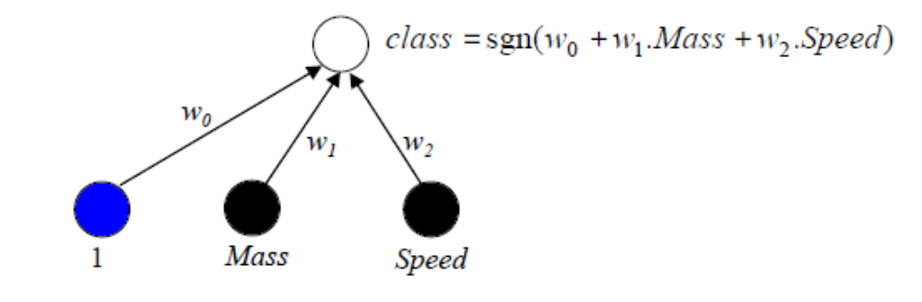
Design of the Classifier - 2

Slide 9
Training
Determine the Training, validation and test sets.
Use the Perceptron code in Python.
Train the network (ensure validation of learning) and then test it.
Repeat any steps as needed.

Slide 10
Validation, Testing & Accuracy
Check validation using Early Stopping
Use Confusion Matrix.
Use Accuracy Matrix.

